Slide 1


Analyzing the Cost of Living in the United States
CS5593 - Data Mining
3rd Semester, Fall 2024
GROUP MEMBERS:
Sasank Sribhashyam
Hima Deepika Mannam
Venkat Tarun Adda
YouTube Presentation Link:
https://youtu.be/A7ncpAAvnLc?si=CVqH4yippOnH3fhF

Slide 2
OUTLINE
Project Overview
Introduction
Related Work
Application
Methodology: Gradient Boosting Model
Feature Selection
Challenges and Improvements
Results and Analysis: Model Comparison
Results and Analysis: Gradient Boosting Performance
Results and Analysis: Feature Importance
Demo
Conclusions & Future Work

Slide 3
Project Overview
Objective: Predict the total cost of living across U.S. regions using machine learning models.
Key Factors: Housing, food, transportation, childcare, taxes, and healthcare.
Outcome: A user-friendly application providing real-time cost predictions.
Significance: Supports decision-making for individuals, businesses, and policymakers.

Slide 4

Introduction
Motivation:
Rising costs of housing, food, and healthcare affect millions in the U.S.
Current tools lack precision and user accessibility for dynamic cost prediction.
Problem Statement:
Need for accurate, user-friendly cost prediction tools to support financial decisions for individuals, businesses, and policymakers.
Objective:
Design a robust, machine-learning-powered system for predicting regional cost of living.

Slide 5
Related Work
Previous Studies:
Regression models for cost predictions lacked real-time tools.
Research Insights:
Friedman (2001): Gradient Boosting 2019's effectiveness in capturing complex data relationships.
Domingos (2012): Challenges with noisy data and regional variations.
Contribution:
Bridging gaps with robust models and a user-friendly application.

Slide 6
Proposed Work
1. Data Collection & Preprnormalize
Gather a comprehensive dataset of living cost factors (e.g., housing, food, childcare).
Handle missing values, normalize features, and encode categorical data.
2. Feature Selection
Identify the most critical predictors using techniques like correlation analysis and feature importance.
3. Model Selection & Training
Compare models (Linear Regression, Ridge Regression, Gradient Boosting, Random Forest).
Optimize the best-performing models for noisy and non-linear datasets.

Slide 7
4. System Development
Build a backend using Python for efficient data processing and prediction.
Develop an interactive frontend using Streamlit for real-time user input and cost predictions.
5. Evaluation
Test models under various conditions (clean, noisy, and non-linear data).
Validate performance using metrics like R² and Mean Squared Error (MSE).

Slide 8

Application
User-Friendly Features:
Real-time input for cost factors.
2. Instant predictions for total cost of living.
3. Dynamic visualizations for better insights.

Slide 9
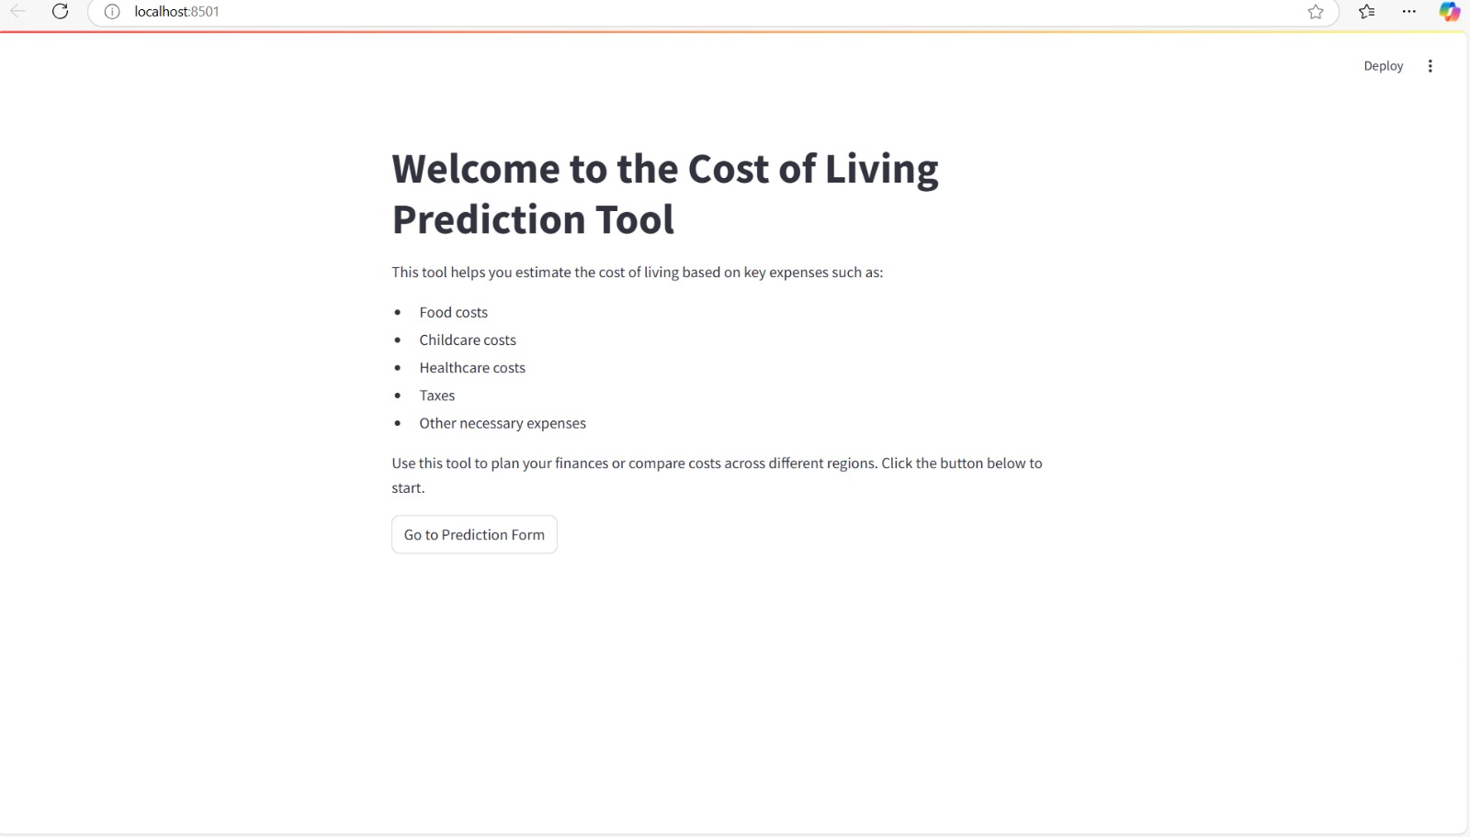

Slide 10
Tools and Technologies Used
Frontend Tools
Streamlit
Developed an interactive web application.
Provided real-time user input for cost-of-living predictions.
Delivered dynamic visualizations for insights.
Backend Tools
Python
Primary language for backend logic.
Libraries utilized:
Scikit-learn: Implemented Gradient Boosting and Ridge Regression models.
Pandas & NumPy: Data manipulation and preprocessing.

Slide 11
Data Preprocessing Tools:
StandardScaler: Scaled numerical data for consistent model performance.
One-Hot Encoding: Converted categorical features into machine-readable formats.
Matplotlib: Created visualizations to validate preprocessing steps.
Development Environment:
Jupyter Notebook
Used for training, testing, and validating machine learning models.
Git/GitHub
Enabled version control and collaboration during development.

Slide 12
Methodology: Gradient Boosting Model
Why Gradient Boosting for This Project?
1. Handling Complex Relationships: Captures non-linear dependencies effectively.
2. Robustness to Noisy Data: Performs well even with real-world data imperfections.
3. Feature Prioritization: Identifies and emphasizes impactful variables.
4. Accurate Predictions: Achieved consistently high R² scores across scenarios.

Slide 13
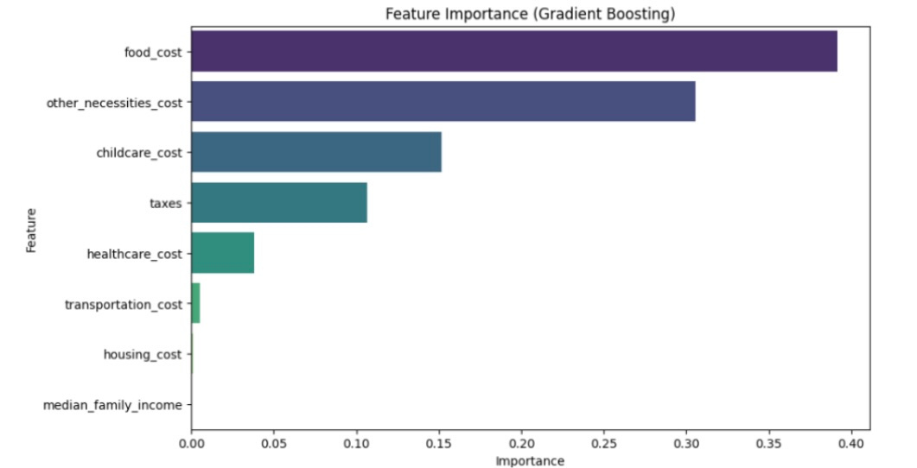

Slide 14

Feature Selection
Techniques Used:
Correlation analysis to identify impactful features.
Gradient Boosting feature importance for ranking predictors.
Key Predictors:
Food_cost (40%), childcare_cost (20%), housing_cost (15%).
Impact:
Improved accuracy and reduced overfitting.

Slide 15
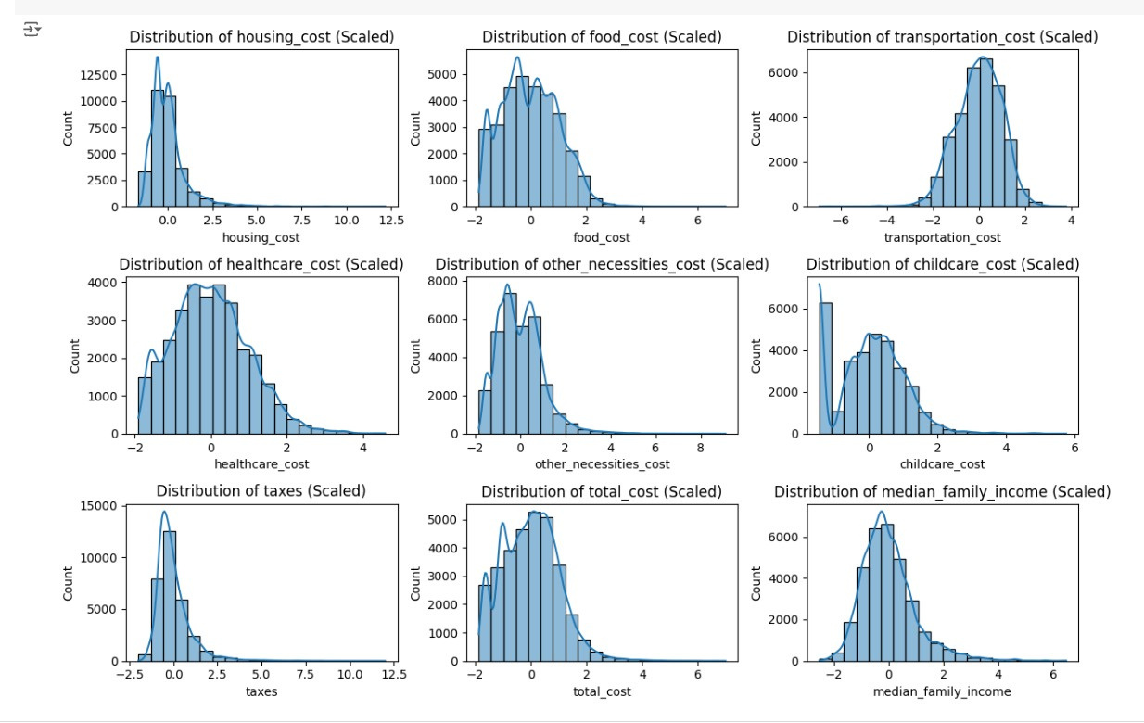

Slide 16

Experiments Conducted
Experiment 1: Model Performance on Standard Data
Description: Models were tested on a clean, preprocessed dataset.
Steps:
Missing values were imputed.
Numerical features were normalized using StandardScaler.
Models trained and evaluated using clean data.
Purpose:
Establish baseline performance under ideal conditions.

Slide 17
Experiment 2: Robustness to Noise
Description: Random noise was added to the dataset to mimic real-world imperfections.
Steps:
Noise was injected into numerical features.
Models trained and evaluated on noisy data.
Performance was measured for stability and robustness.
Purpose: Assess models' ability to handle inaccuracies in data.

Slide 18
Experiment 3: Handling Non-Linear Relationships
Description: Non-linear relationships were introduced by adding polynomial features.
Steps:
Polynomial transformations applied to key features.
Models trained and tested on the transformed data.
Performance evaluated for capturing non-linear dependencies.
Purpose: Determine models' capability to adapt to complex feature interactions.

Slide 19
Results and Analysis: Model Comparison
Performance on Standard Data:
Linear Regression: R² = 1.00, MSE = 0.00 (Overfit).
Ridge Regression: R² = 0.95, ideal for clean data.
Gradient Boosting: R² = 1.00, robust for non-linear relationships.
Decision Trees: R² = 0.95, prone to overfitting, MSE = 23,803,000.

Slide 20
Results and Analysis: Gradient Boosting Performance
Clean Data: R² = 1.00, MSE = 1,969,036.
Noisy Data: R² = 1.00, MSE = 2,089,898.
Non-linear Data: R² = 1.00, MSE = 2,190,498.
Key Insight: Gradient Boosting adapts to diverse data complexities.

Slide 21

Results and Analysis: Feature Importance
Top Predictors:
Food_cost (40%), childcare_cost (20%), housing_cost (15%).
Correlation Analysis:
Housing and food costs show strongest linear correlation to total cost.
Takeaway:
Prioritizing impactful features enhances prediction accuracy.

Slide 22
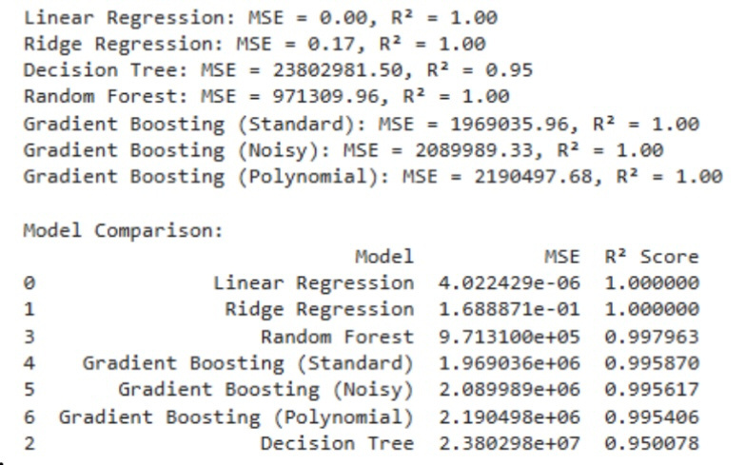

Slide 23
DEMO
Interactive Dashboard
Features:
Input fields for housing, food, and other expenses.
Predicts total cost of living with detailed breakdowns.
Steps Demonstrated:
Enter data for a region.
View prediction output with bar charts and heatmaps
Adjust parameters to explore changes dynamically.

Slide 24
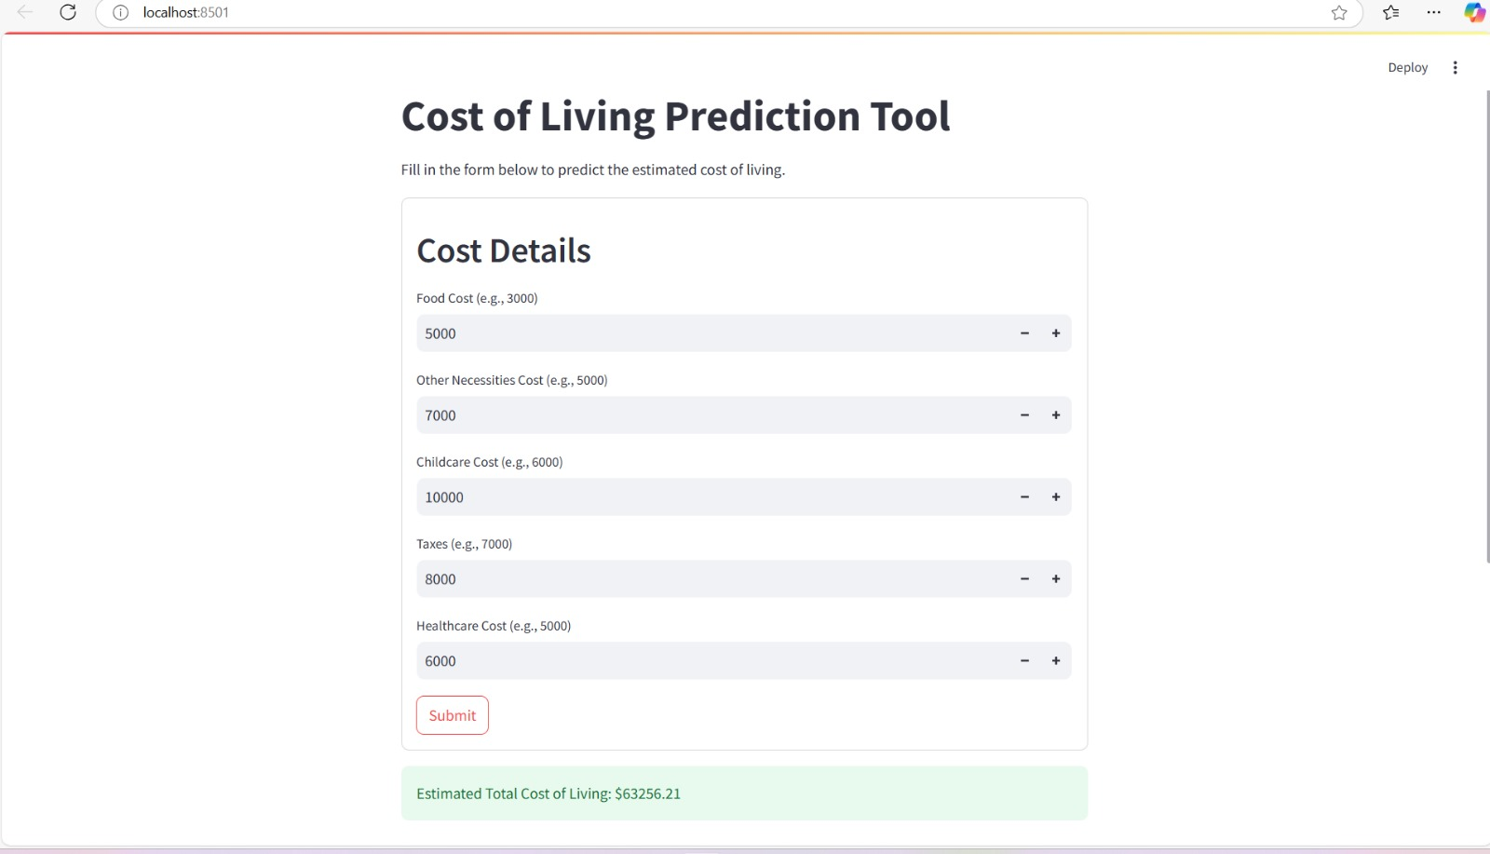

Slide 25
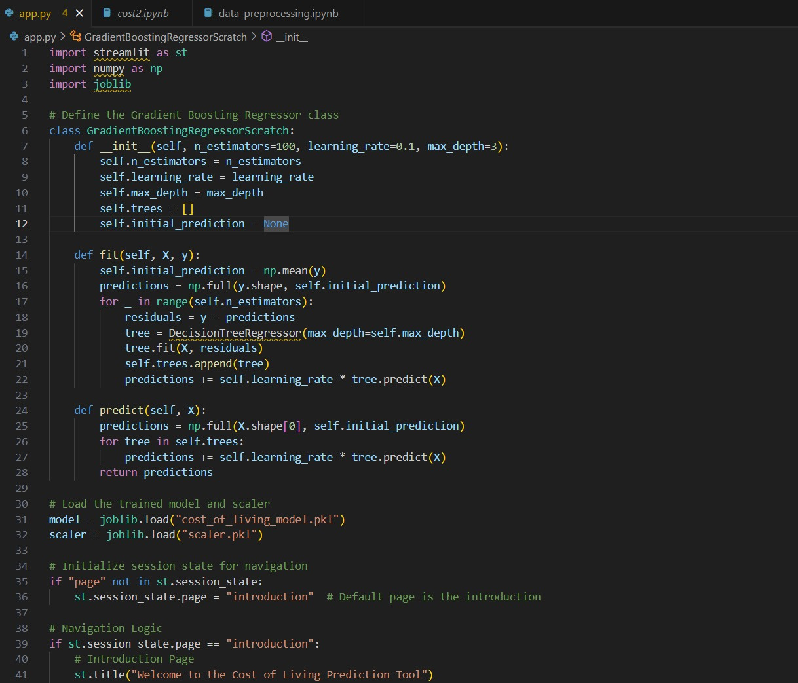

Slide 26
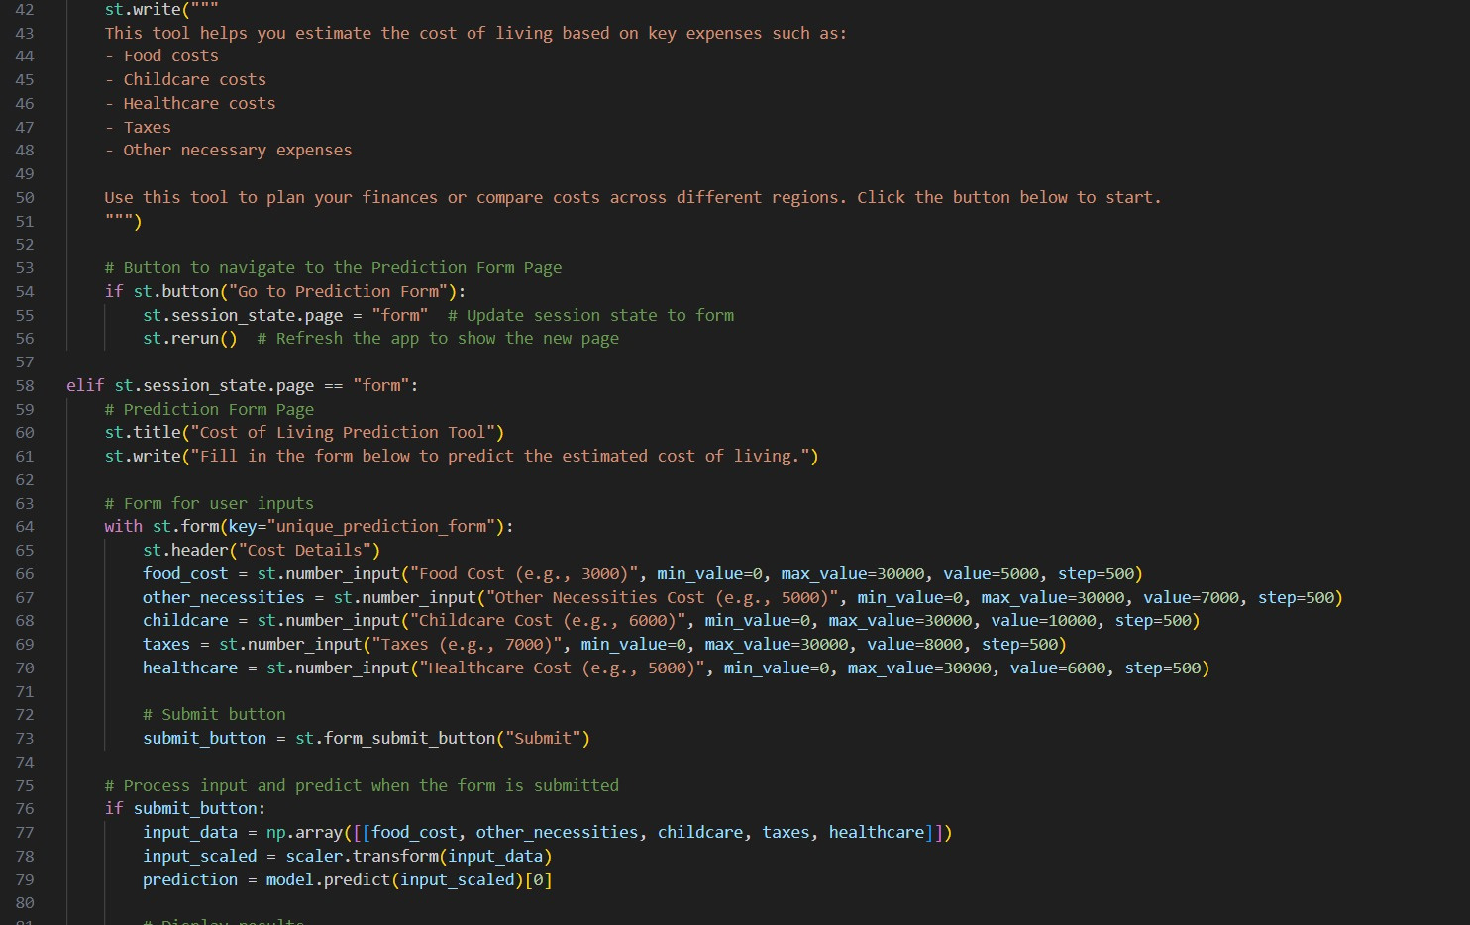

Slide 27


Slide 28
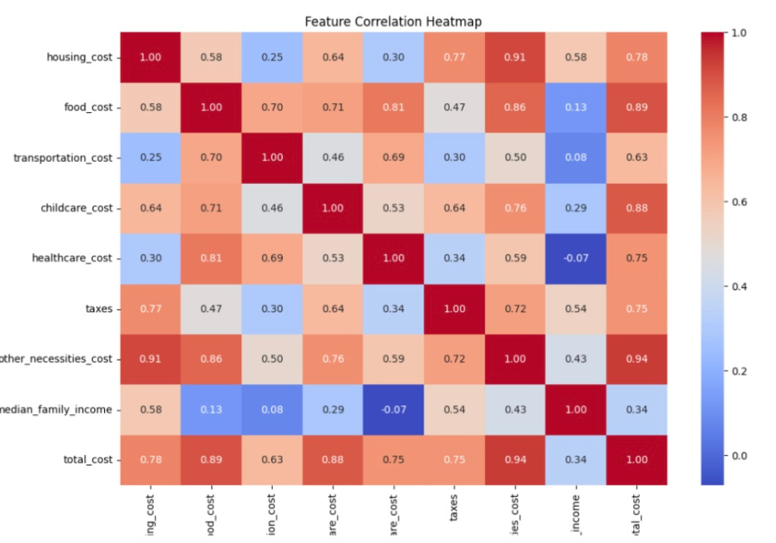

Slide 29
Correlation Matrix Overview
Purpose:
This correlation matrix visualizes the relationships between various expense categories and median family income.
Key Observations:
Strong Positive Correlations
Housing & Other Necessities (0.91):
High housing costs often indicate higher costs in other necessities.
Total Cost & Other Necessities (0.94):
Other necessities significantly drive total costs.

Slide 30
Moderate Correlations
Food & Healthcare (0.81):
Indicates a link between rising food and healthcare expenses.
Childcare & Total Cost (0.88):
Childcare is a major contributor to overall expenses.
Weaker Correlations
Income & Costs:
Median family income shows weaker correlations with specific costs, except for a moderate link with housing (0.58).

Slide 31

Challenges and Improvements
Challenges Faced:
Noisy and incomplete data.
Regional disparities in cost factors.
Solutions Implemented:
Data cleaning techniques and robust models like Gradient Boosting.
Future Enhancements:
Include more regions and factors (e.g., entertainment, environmental conditions).

Slide 32

CONCLUSION
Achievements:
Developed a robust machine-learning-based prediction tool.
Gradient Boosting proved ideal for real-world scenarios.
User-friendly dashboard bridges analytics and usability.
Impact:
Actionable insights for financial planning, policy-making, and business strategy.
Achievements:
Developed a robust machine-learning-based prediction tool.
Gradient Boosting proved ideal for real-world scenarios.
User-friendly dashboard bridges analytics and usability.
Impact:
Actionable insights for financial planning, policy-making, and business strategy.

Slide 33
Future Work
Data Enhancements:
Integrate live data streams (e.g., inflation, market trends).
Include socioeconomic metrics like quality of life.
Technical Advancements:
Explore deep learning models (e.g., RNNs) for temporal data.
Enhance transparency with explainable AI.
User Features:
Add geospatial cost visualizations.
Expand scope to include affordability indices and policy simulation
tools.

Slide 34
REFERENCES
1. Witten, I. H., Frank, E., & Hall, M. A. (2011). Data Mining: Practical Machine Learning Tools and Techniques (3rd ed.). Morgan Kaufmann.
2. Rousseeuw, P. J. (1987). Silhouettes: A graphical aid to the interpretation and validation of cluster analysis. Journal of Computational and Applied Mathematics, 20, 53-65. DOI: [10.1016/0377-0427(87)90125-7](https://doi.org/10.1016/0377-0427(87)90125-7).
3. Friedman, J. H. (2001). Greedy function approximation: A gradient boosting machine. Annals of Statistics, 29(5), 1189-1232. DOI: [10.1214/aos/1013203451](https://doi.org/10.1214/aos/1013203451)
4. Agrawal, R., & Srikant, R. (1994). Fast Algorithms for Mining Association Rules. Proceedings of the 20th International Conference on Very Large Data Bases, 487-499.
5. Hunter, J. D. (2007). Matplotlib: A 2D graphics environment. Computing in Science & Engineering, 9(3), 90-95. DOI: [10.1109/MCSE.2007.55](https://doi.org/10.1109/MCSE.2007.55).

Slide 35
6. Tan, P. N., Steinbach, M., Karpatne, A., & Kumar, V. (2019). Introduction to Data Mining (2nd ed.) Pearson Education, Inc.
7. Halima, G. A., Agustina, P., Adiwijayanto, E., & Ohyver, M. (2022). Estimation of cost of living in a particular city using multiple regression analysis and correction of residual assumptions through appropriate methods. 7th International Conference on Computer Science and Computational Intelligence, 2022.
8. Reddy, P. K. V., Haran, K. H., Chowdary, P. S., & George, G. V. S. (2022). Global Cost of Living Using Data Science. 2022 IJCSPUB, Volume 12, Issue 1, March 2022 | ISSN: 2250-1770.
9. Friesen, J., Rausch, L., Pelz, P. F., & Fürnkranz, J. (2018). Determining Factors for Slum Growth with Predictive Data Mining Methods. Urban Science, 2(3), 81. DOI: [10.3390/urbansci203008](https://doi.org/10.3390/urbansci203008).
10. Domingos, P. (2012). Prediction of the Cost of Living Index Using Machine Learning Techniques. Retrieved from [www.medium.com](https://www.medium.com)
11. Kaggle (2024). US Cost of Living Dataset. Retrieved from [https://www.kaggle.com/datasets/asaniczka/us-cost-of-living-dataset-3171-counties](https://www.kaggle.com/datasets/asaniczka/us-cost-of-living-dataset-3171-counties)

